Slide 1

Setting up an Integrated Development Environments (IDE), Virtual Environment, Overleaf, LaTeX, and GitHub
DSCI 222: Overview

Slide 2
Is Data Science in High Demand?
What skills do I need to be an excellent data scientist?
The Bureau of Labor Statistics projects 35.8% employment growth for data scientists between 2021 and 2031. In that period, an estimated 40,500 jobs should open up.

Slide 3
Health
Physics
Mathematics
Computer Science
…
…
Atmospheric Sciences
Prob & Stat
Finance

Slide 4
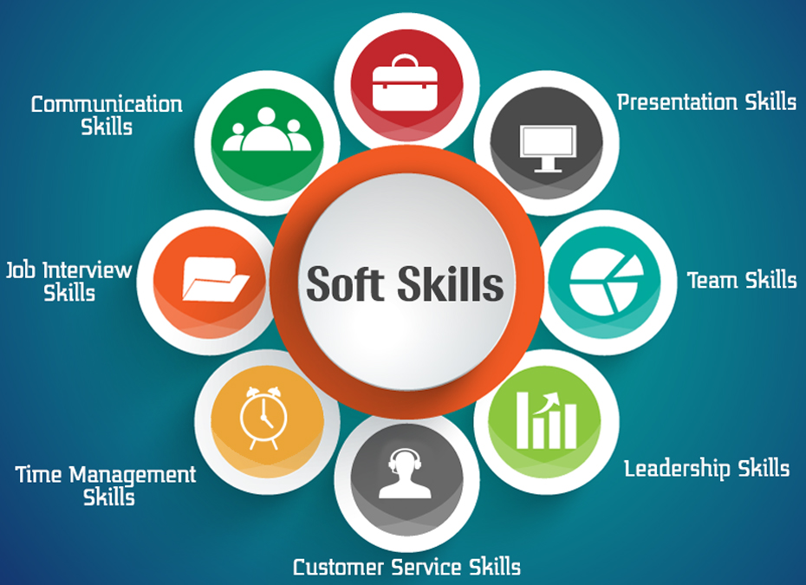
https://www.insofe.edu.in

Slide 5
To keep in mind…
Although our main focus is towards data manipulation, analysis and visualization through Python, during this course It is expected to further develop all other necessary skills to be an excellent data scientist.
In-person
Recordings
Projects
Assignments
Presentation
Guests
Passion

Slide 6

Tools to succeed
Visual Studio Code
Jupyter Notebooks
Google Colab
Anaconda.Navigate
Conda
LateX
Overleaf
Github
AI Assistants
PyCharm
https://forms.gle/ERuDtSETousxazyk7

Slide 7
Anaconda
VS Code and PyCharm
Python IDE
Multiple applications and IDEs can be run through Anaconda.Navigator
Jupyter Notebook (Google Colab alternative)
Combination of Julia, Python, and R, highlighting its support for multiple languages through the use of different kernels
Environment manager
Conda (alternative to pip)
Easy Package Management
Many pre-installed packages generally used in machine learning and data science

Slide 8
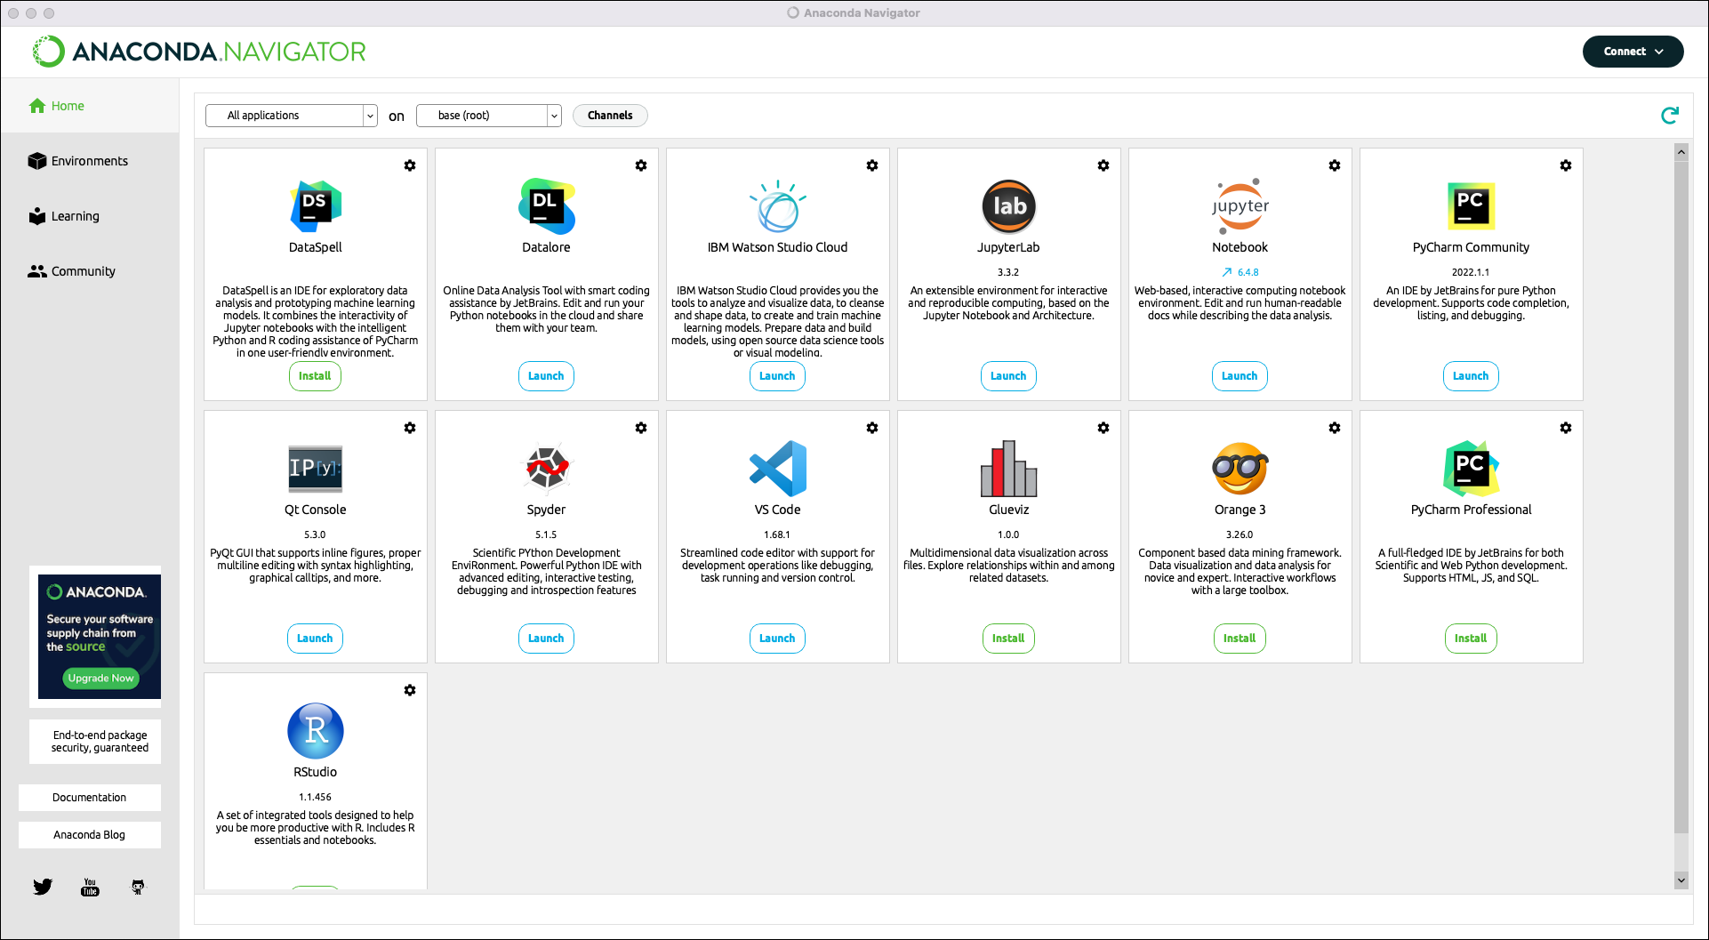

Slide 9


VS Code or PyCharm
Lightweight Code Editor vs Full Featured IDE
Jupyter (requires extension) vs PRO feature
Limited AI Support vs PRO feature
Python support (requires extension for VS Code)
Supports multiple languages vs primarily just Python

Slide 10
Virtual Environments: venv and conda
A virtual environment is an isolated workspace that contains its own Python interpreter and libraries — separate from the system-wide Python installation.
venv | Built-in Python module for creating lightweight environments | Simple projects Python-only Uses pip
Conda* | Environment manager from Anaconda; supports non-Python packages too | Data science Machine Learning Scientific computing
*I will be using a DSCI 222 virtual environment, created in Anaconda

Slide 11
Python isn’t the only language we will be using
Markdown
LaTeX

Slide 12

Used to create Jupyter Notebooks
Uses Markdown for notebook cells
Made for collaboration
Natively supports many Data Science packages
No installation needed, only a Gmail account
Cloud-based
Access to datasets through Google Drive

Slide 13
Collaboration while writing Python code
One of the most important features of Google Colab is the ability to share your work with others in real-time. You can collaborate with your team members, colleagues, or friends by sharing your Google Colab notebook with them.
Sometimes you may need to share a Google Drive with all the members of Google Colab, especially if you are working on a group project where data needs to be shared among team members.

Slide 14
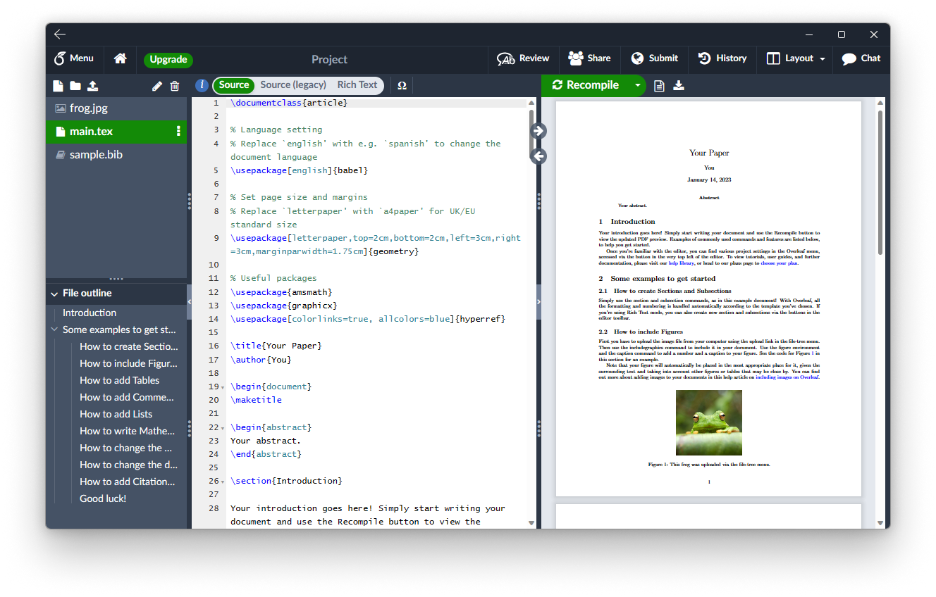
LaTex: Overleaf

Slide 15
Important !!!
DSCI 221 provided you with basic programming skills very useful for this course.
Review Chapters 2 and 3 (from pages 11 to 46) of the book “Introduction to Python for Computational Science and Engineering” by Hans Fangohr. It is an online freely available book, there is a link in the syllabus.
Read and understand the material before next class.
We will use your new skills to solve multiple problems during class.

Slide 16
Summary
There are multiple tools we can use to get important insights from the data.
Python provides ways to manipulate and analyse multiple datasets in a short period of time.
During this course we will learn techniques to extract significant information from data.

